Slide 1

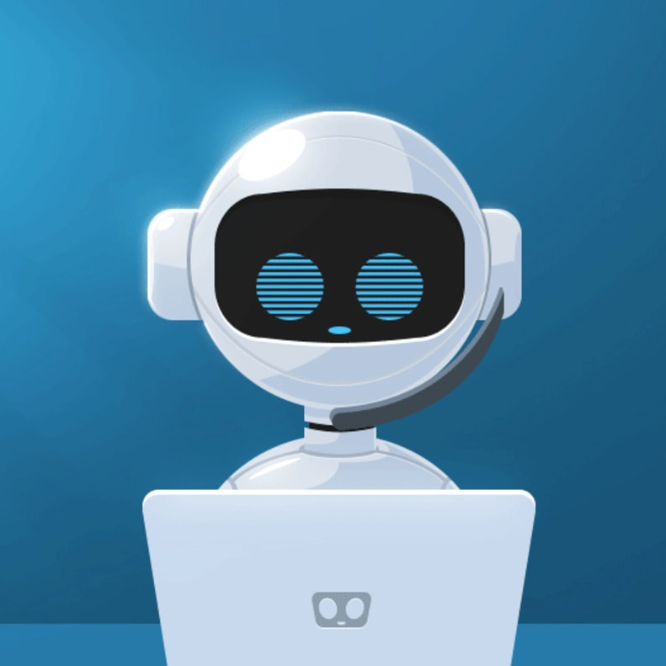
Cloud contact center
Chatbots
Contact Center
Group 9
Srikar Brahmadevara
Suchith Domala
Keerthi Reddy Jagapathi
Praneetha Kannikanti
Shekhar Subedi

Slide 2
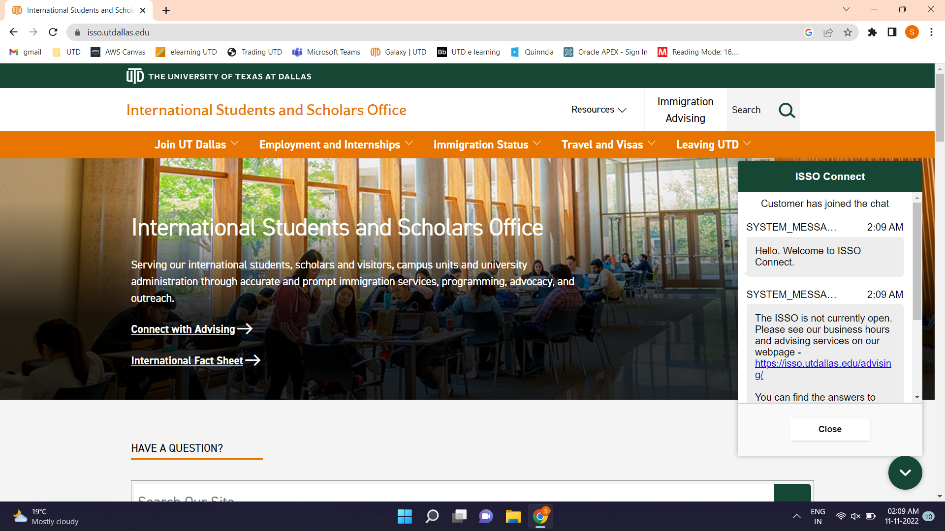

Slide 3
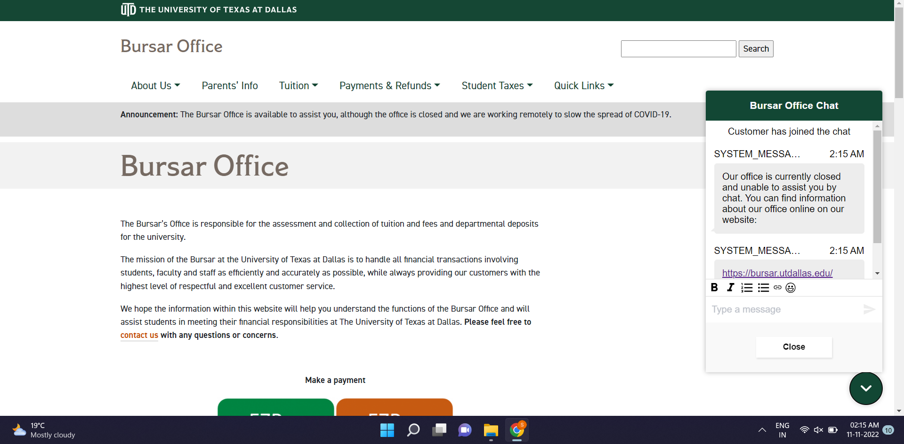

Slide 4
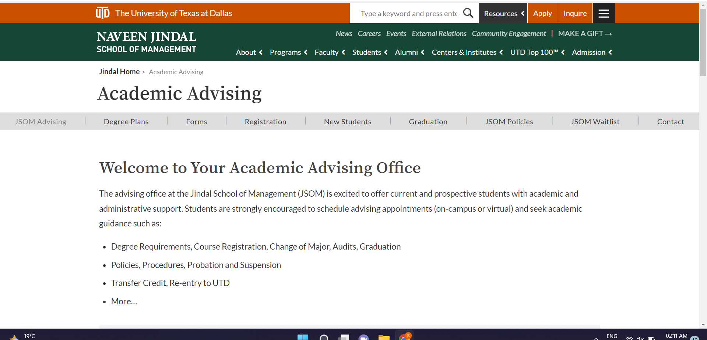

Slide 5
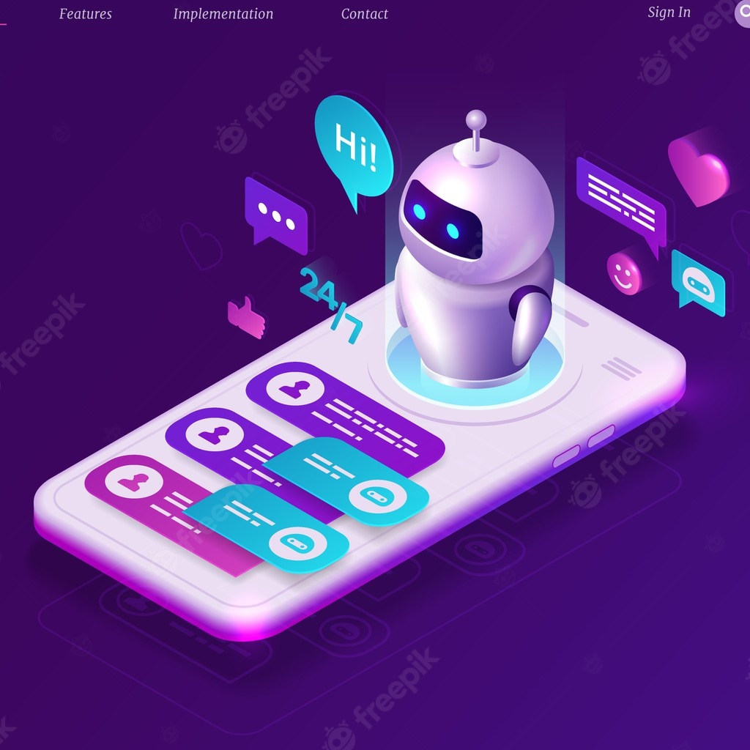

What we propose?
Chatbots
AWS Contact Center

Slide 6
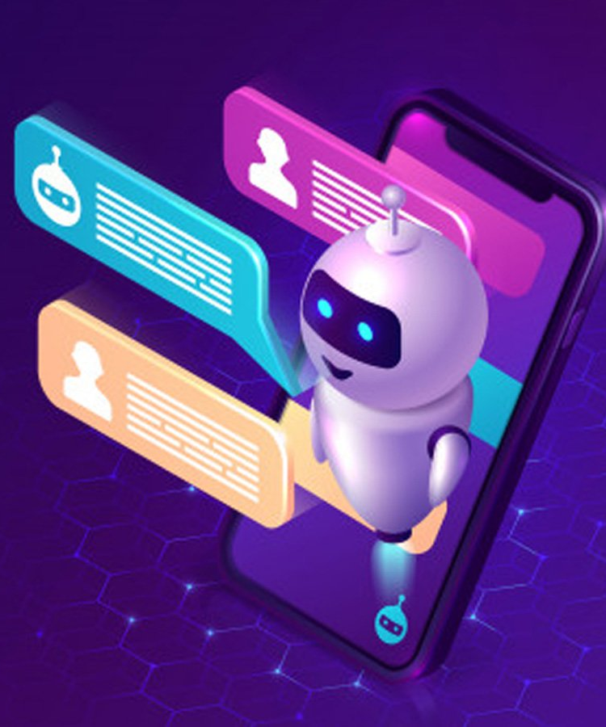
Chatbot
Chatbots are computer programs that maintain a conversation with a user in natural language, understand the user’s intent and send responses based on the organization’s business rules and data.
Driven by AI, automated rules, natural-language processing (NLP), and machine learning (ML), chatbots process data to deliver responses to requests of all kinds.
In Short, chatbots are nothing but virtual assistants programmed to automatically answer the user request
11/16/2022

Slide 7

CLOUD CONTACT CENTER
Amazon Connect is a self-service, omnichannel cloud contact center service that makes it easy for any business to deliver better customer service at lower cost.
Amazon Connect is based on the same contact center technology used by Amazon customer service associates around the world to power millions of customer conversations.
The self-service graphical interface in Amazon Connect makes it easy for non-technical users to design contact flows, manage agents, and track performance metrics – no specialized skills required.

Slide 8



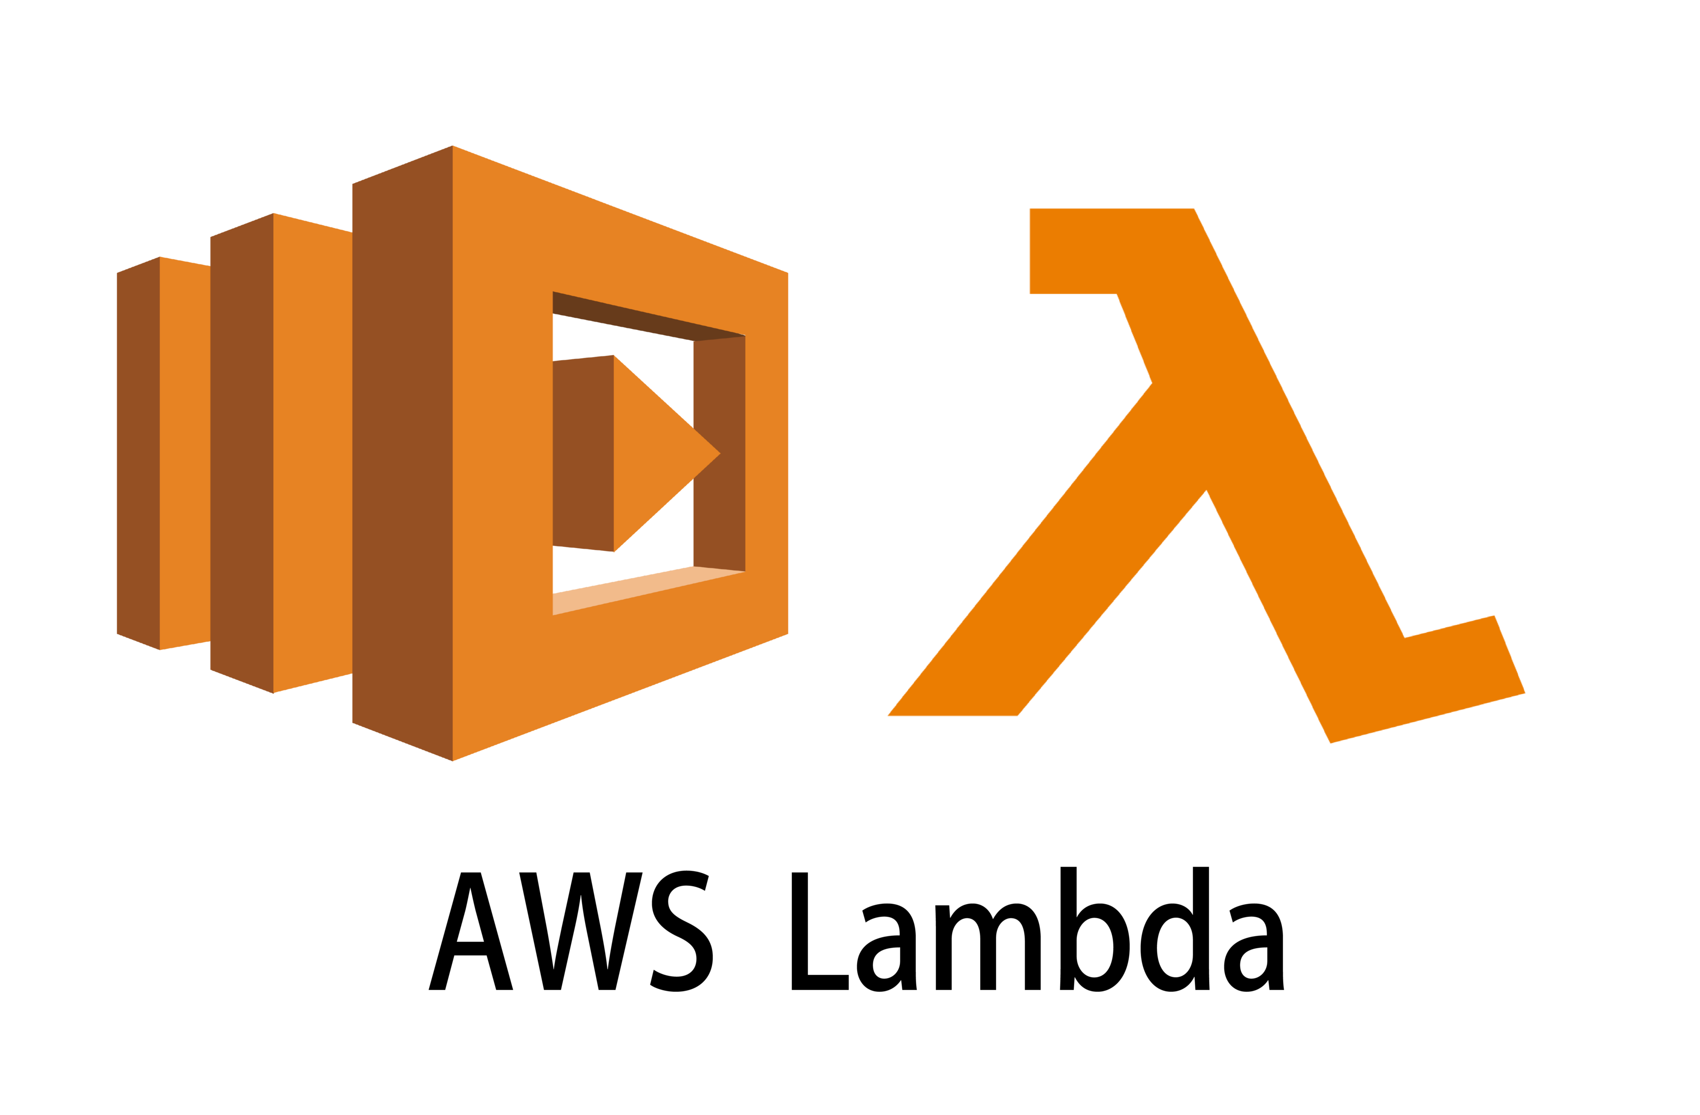




AWS Service
AWS IAM
Cloud Computing MIS 6363

Slide 9
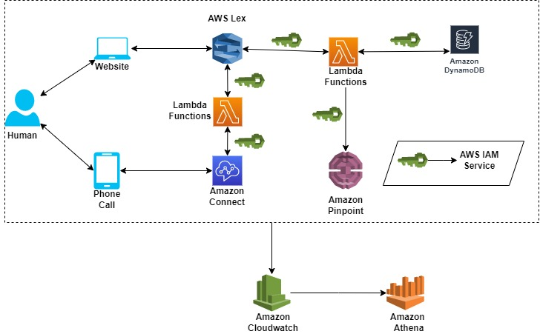
High Level Architecture
Cloud Computing MIS 6363

Slide 10
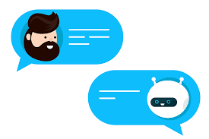
Advantages
11/16/2022
Accessibility anywhere, with any device
Centralized data security
Higher performance and availability
Quick application deployment
Instant business insights
Business continuity
Price-performance and cost savings
Virtualized computing
Cloud Computing MIS 6363
https://www.oracle.com/cloud/what-is-cloud-computing/top-10-benefits-cloud-computing/

Slide 11
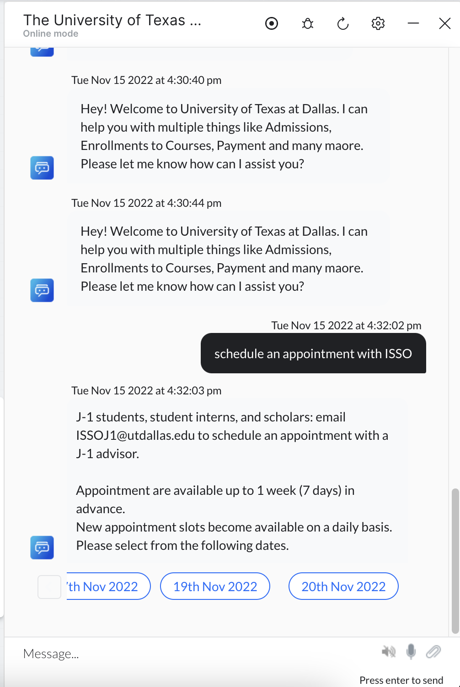

Slide 12
Thank you

